Slide 1
DevOps POC
· Setup Kubernetes(minikube/Vagrant)
· Deploy any sample application to it and access outside.
· Setup Prometheus and Grafana into the Kubernetes Cluster
· Design dashboard in Grafana visualize deployed sample application CPU and memory status.
Submitted By—
Bhabajyoti Kalita

Slide 2

Setting up Kubernetes (minikube)
Kubernetes, also known as k8s, is an open-source system for automating deployment, scaling, and management of containerized applications. It is a portable, extensible open-source platform for managing containerized workloads and services, that facilitates both declarative configuration and automation, letting us run distributed systems resiliently, with scaling and failover for our application.
Minikube is a tool that lets us run kubernetes locally. Minikube runs a single-node kubernetes cluster on our personal computer so that we can try out kubernetes, or for daily development work. It quickly sets up a local Kubernetes cluster on macOS, Linux, and Windows.

Slide 3
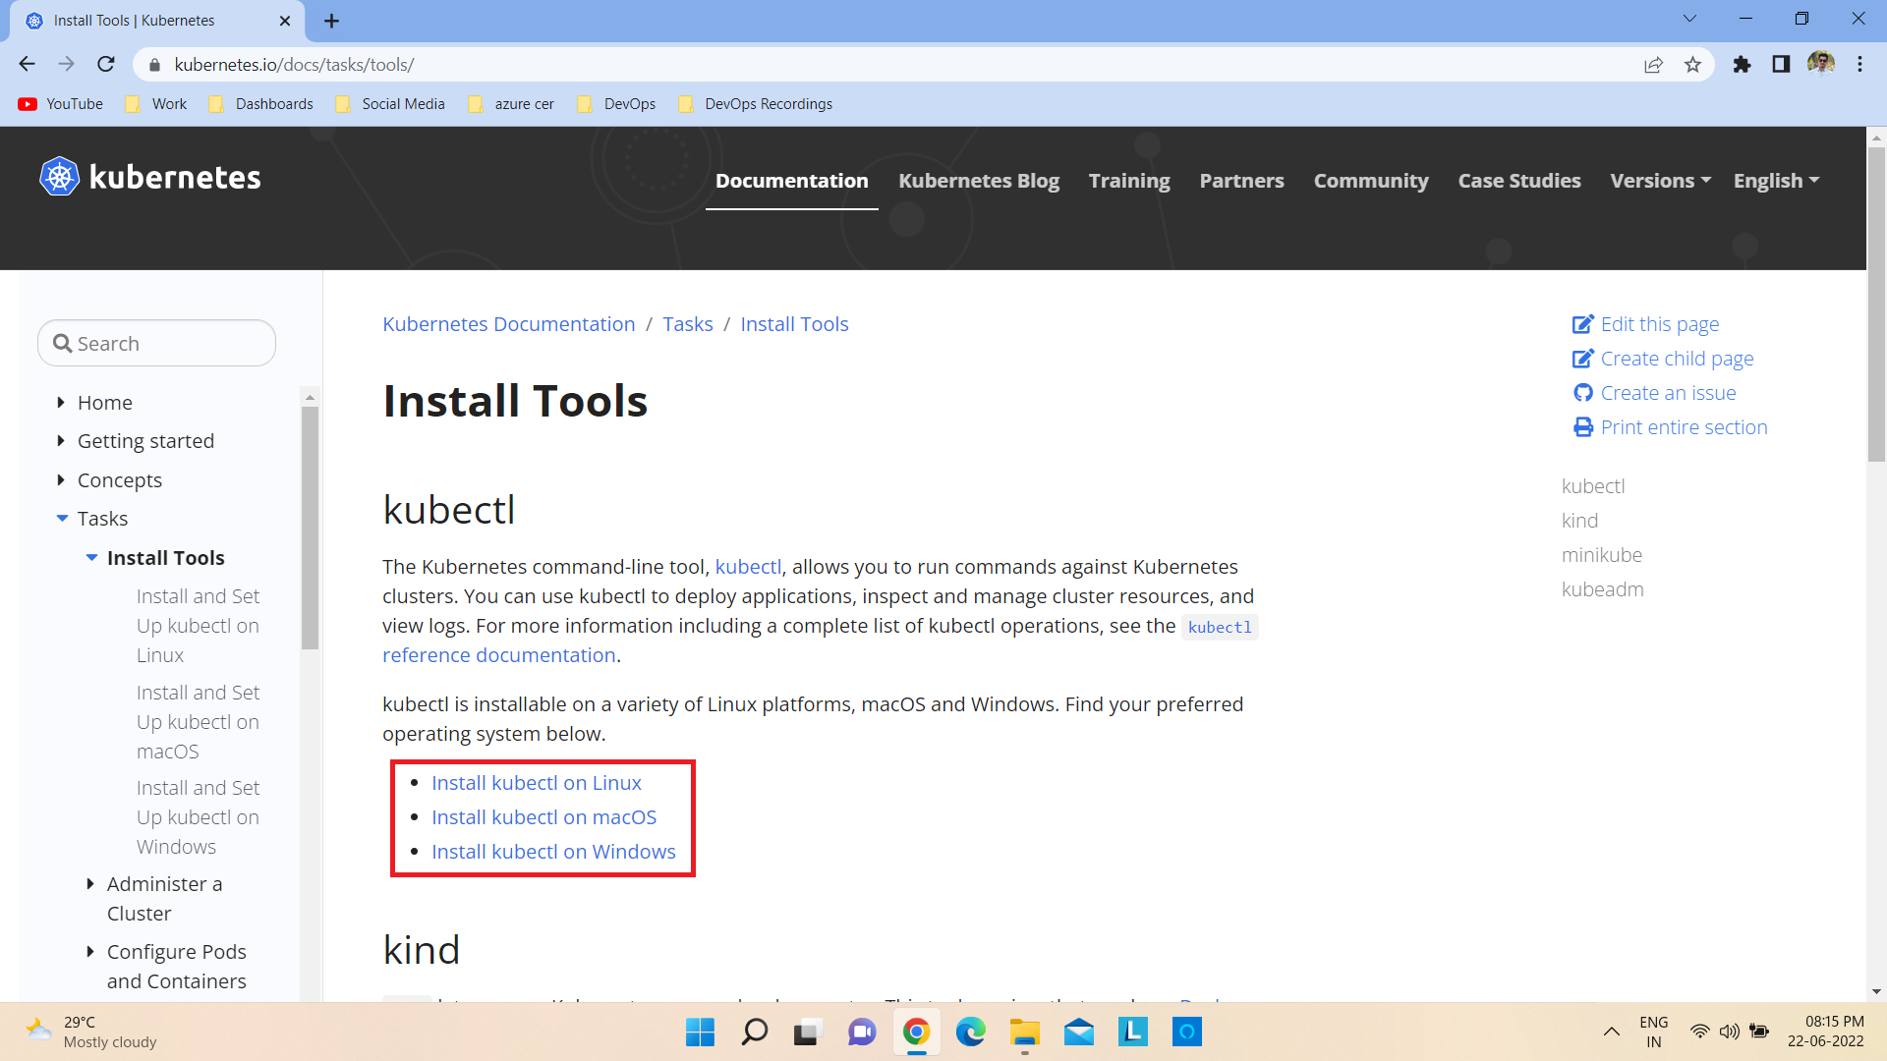
Steps for installation—
1) Go to https://kubernetes.io/docs/tasks/tools/

Slide 4
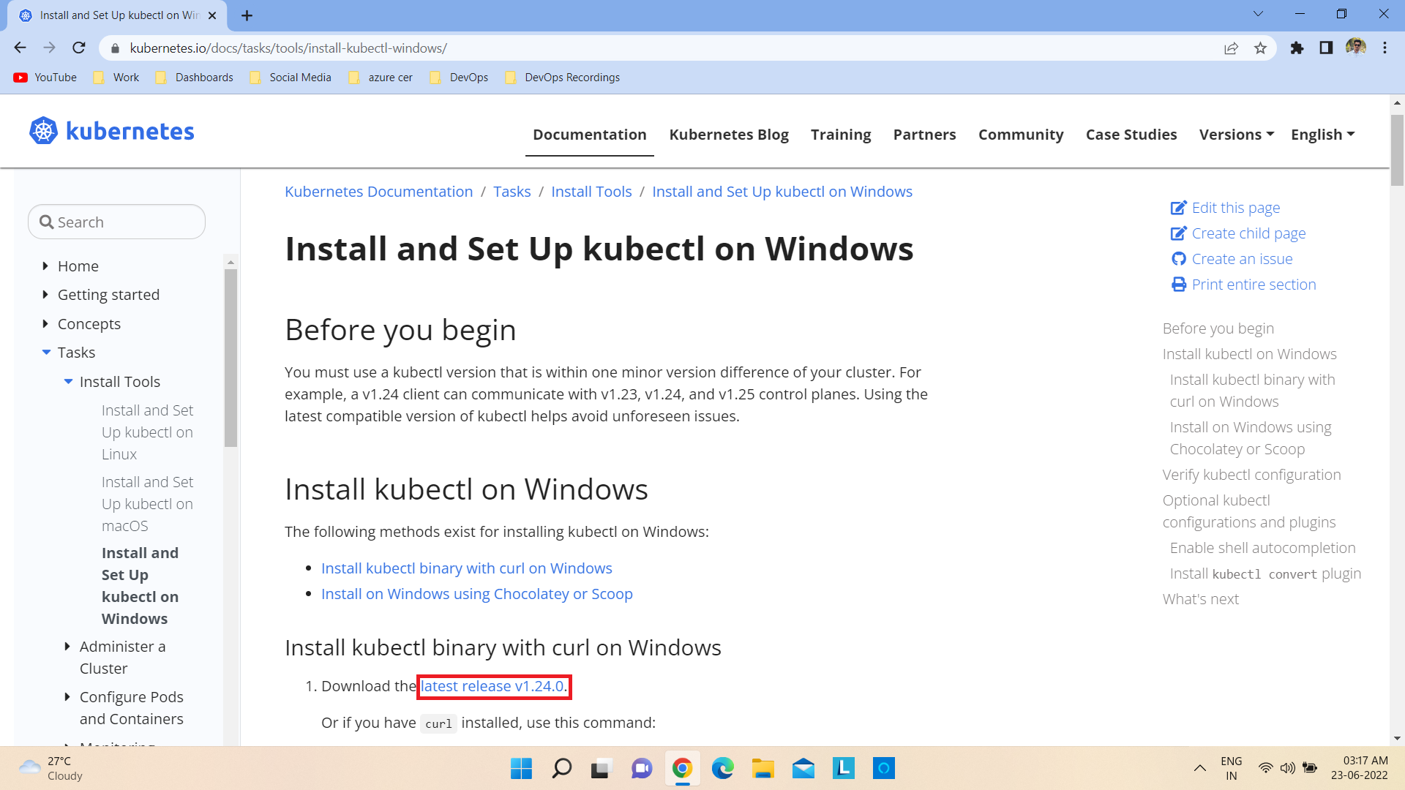
2) Click on latest release v1.24.0 to download the application

Slide 5
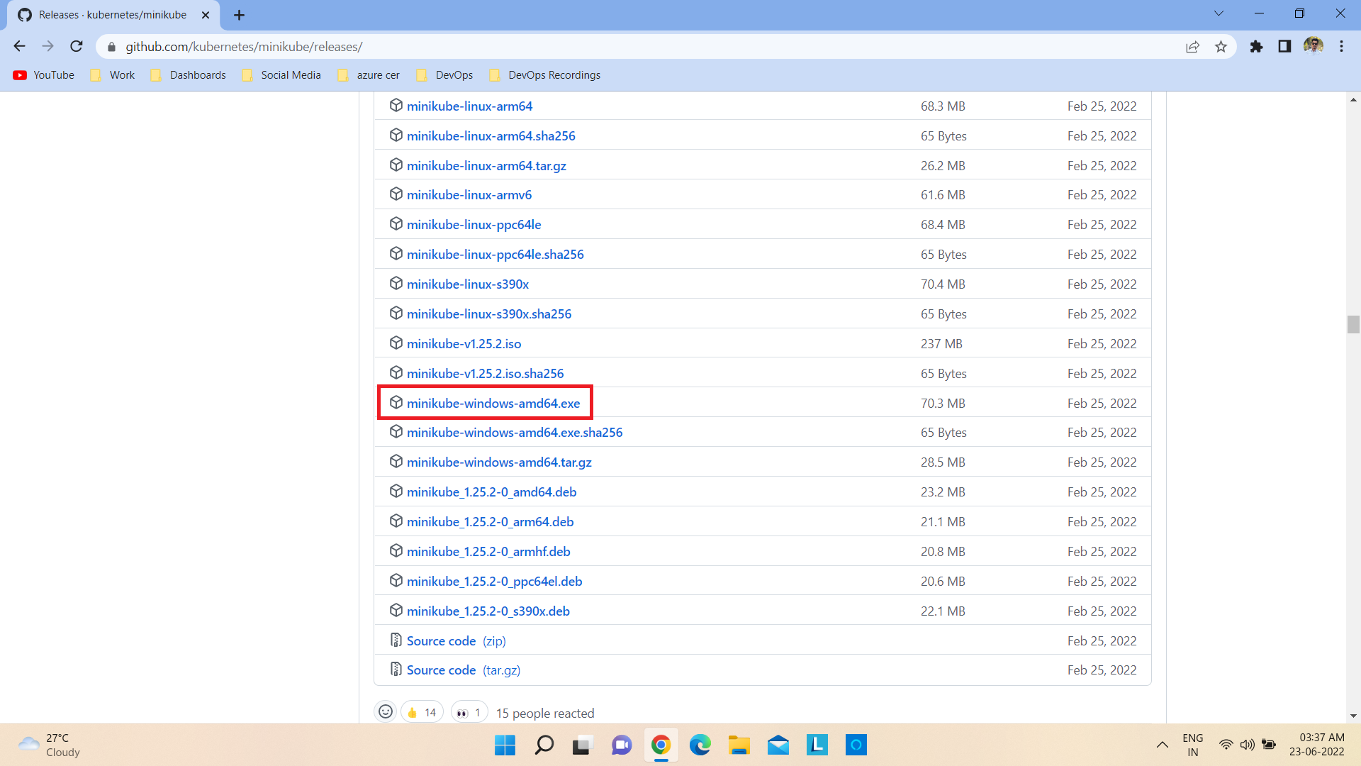
3) Go to https://github.com/kubernetes/minikube/releases/ and click on minikube-windows-amd64.exe to download the minikube application.

Slide 6
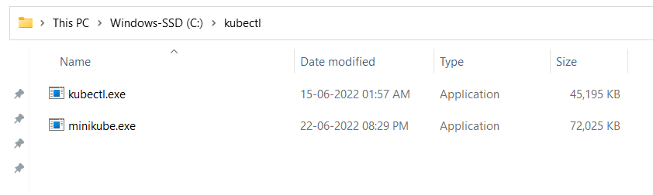
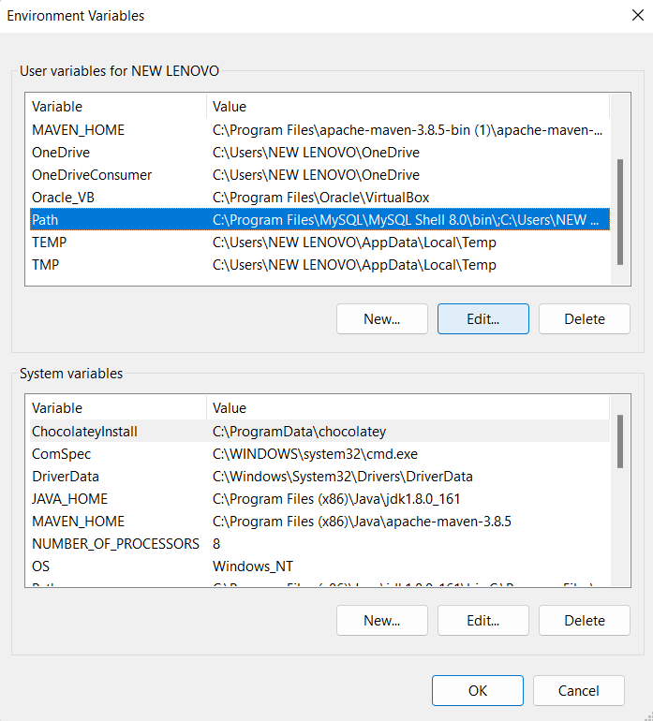
4) Go to the Download folder and copy/cut the kubectl application and minikube application, and paste it in a folder of any name.
5) Go to Environment Variables and select Path and then click on Edit.

Slide 7
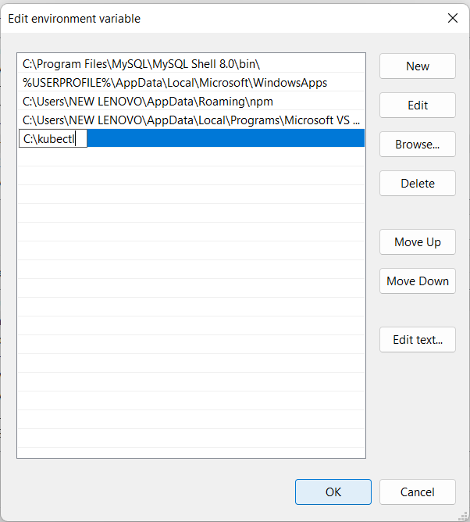
6) Click on New and paste the path of the folder which contains the kubectl and minikube applications and then click on OK.

Slide 8
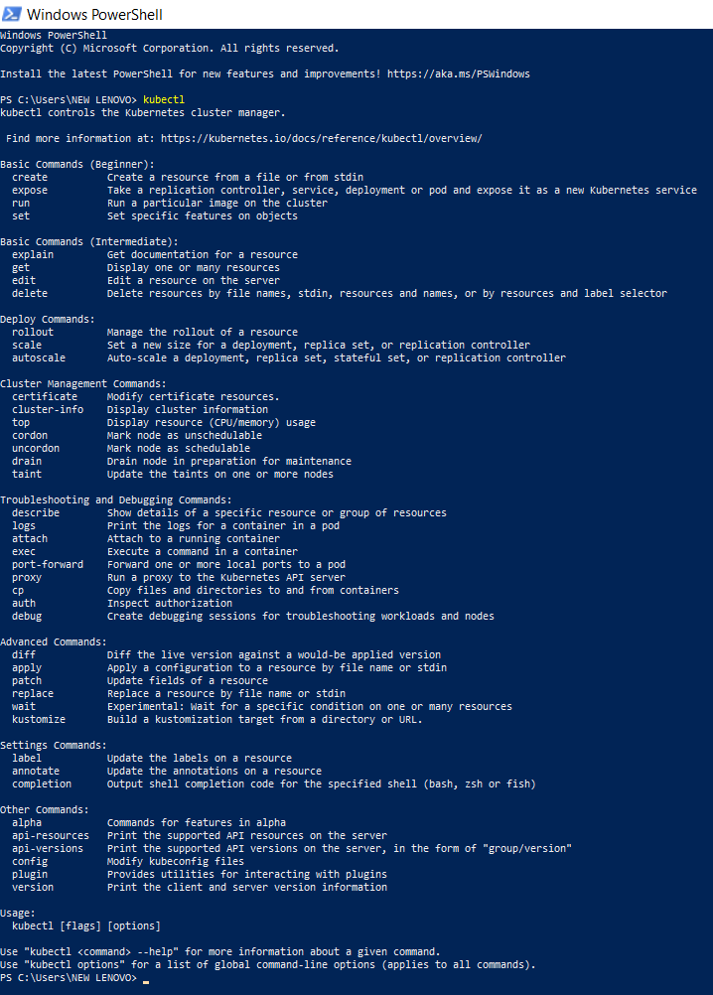
7) Open Windows PowerShell and type kubectl and press Enter to check whether kubectl is installed or not.

Slide 9
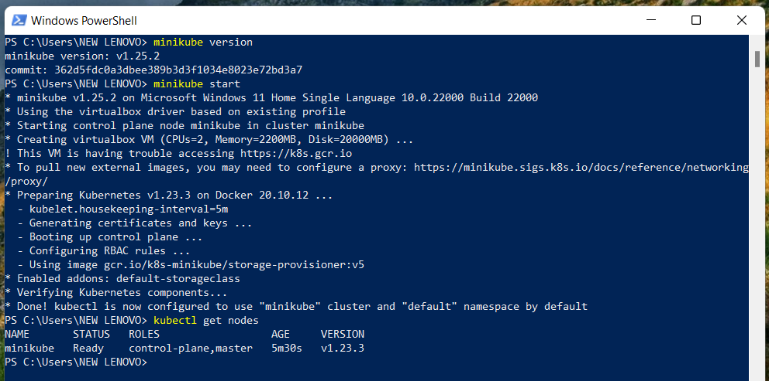
8) Open Windows PowerShell and type minikube version and press Enter to check whether minikube is installed or not.
9) Type minikube start and press Enter to start minikube.
10) Type kubectl get nodes and press Enter to check whether minikube is ready.

Slide 10
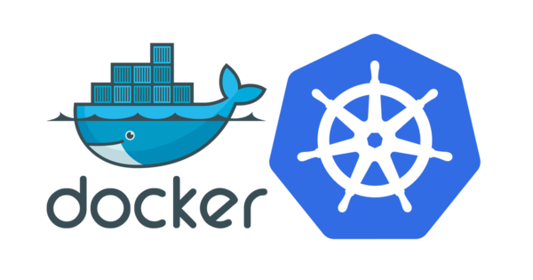
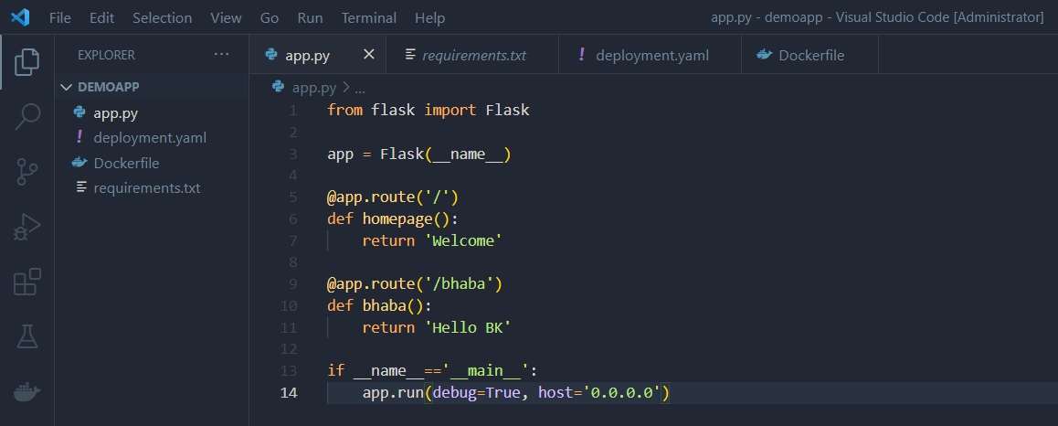
Deploying sample application to Kubernetes
1) Create a folder with any name (For example: demoapp) and open it in VS Code as admin.
2) Create the application file inside the folder (For example: app.py).

Slide 11
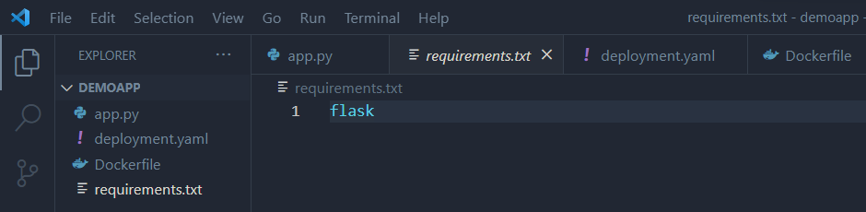
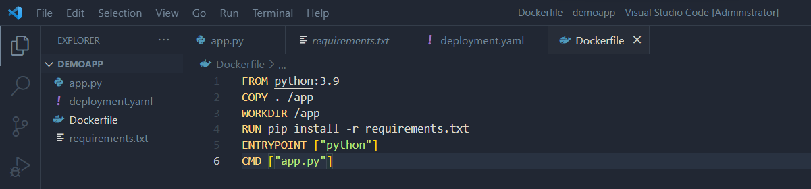
3) Create a requirements.txt file for it.
4) Create a Dockerfile for it.

Slide 12
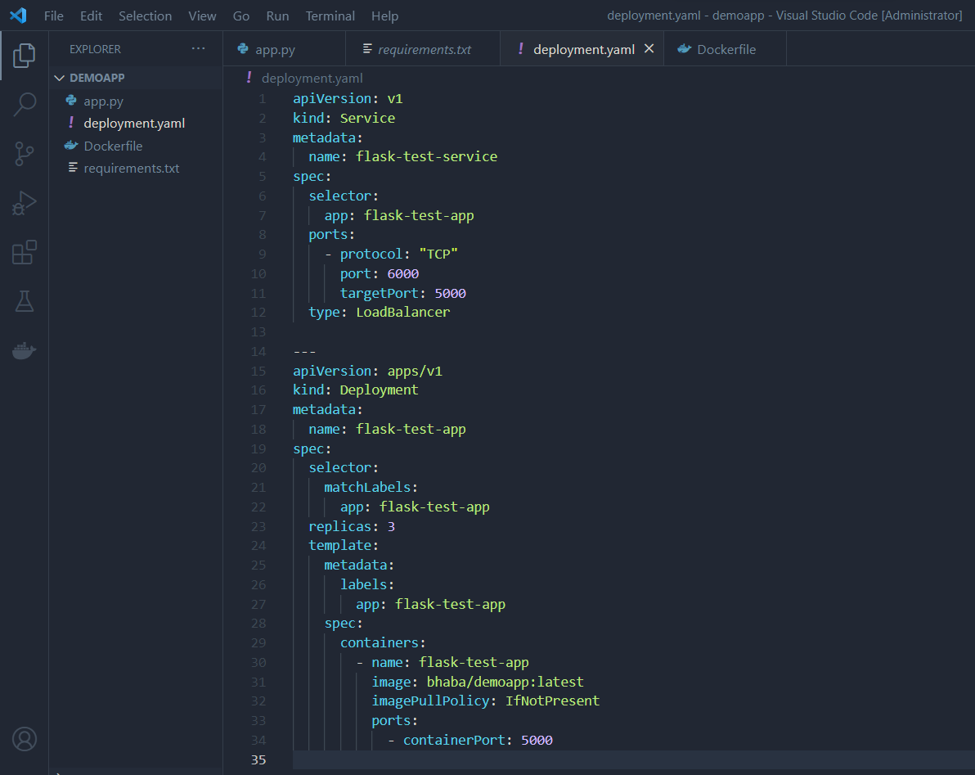
5) Create a deployment.yaml file for it.

Slide 13
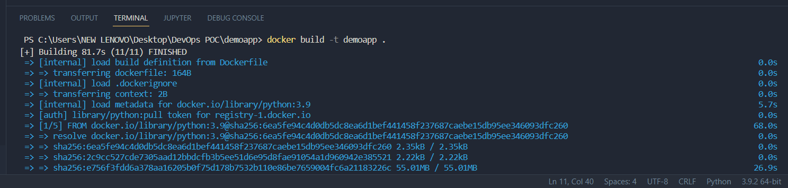
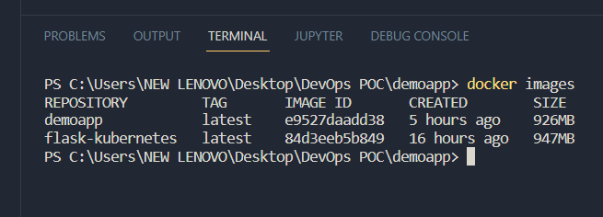
6) Run the docker build –t <image-name> . command to create a docker image of the application.
7) Run the docker images command to view the list of images created.

Slide 14
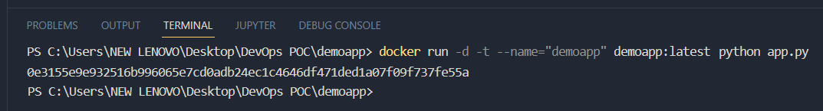
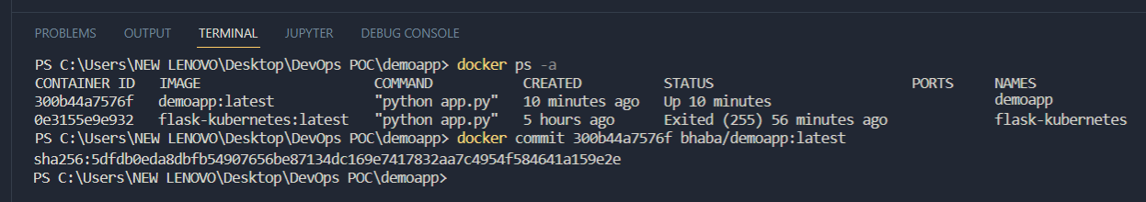
8) Run docker run –d –t –name=“< repository-name >” <repository-name>:<tag-name> python <app-name> command to create a docker container of the image.
9) Run the docker ps –a command to view the list of containers created.
10) Run docker commit <container-id> <dockerhub-username>/<image-name> command to commit the changes in the local repository.

Slide 15
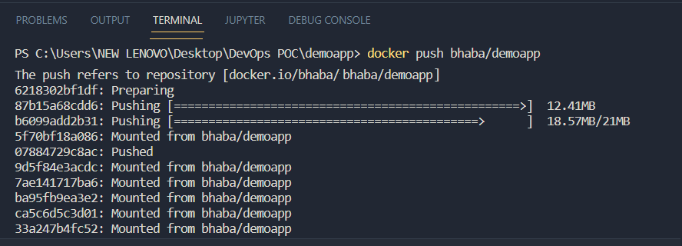
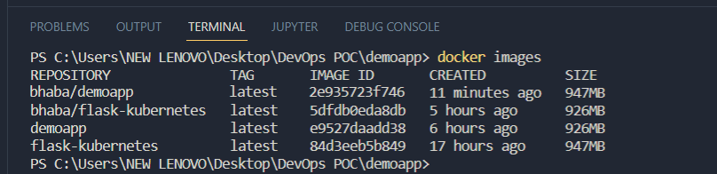
11) Run docker push <dockerhub-username>/<repository-name> command to push the image from local repository to the dockerhub central repository.
12) Run the docker images command to view and verify whether the image is created or not.

Slide 16
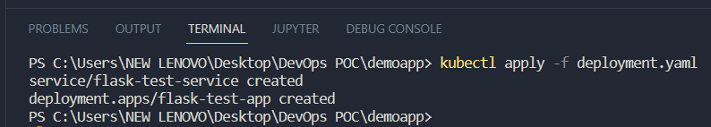
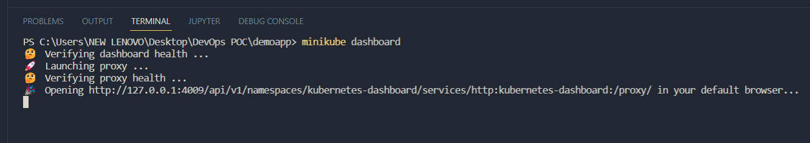
13) Run kubectl apply –f deployment.yaml command to create Kubernetes resources defined in the deployment.yaml file.
14) Run minikube dashboard command to open the Kubernetes dashboard and view the deployment.

Slide 17
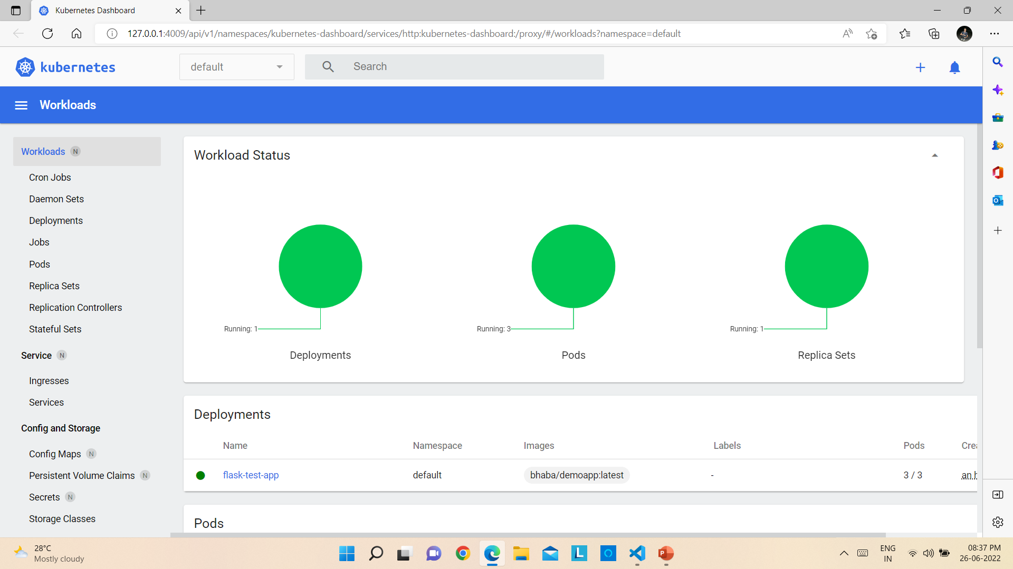
Kubernetes Dashboard

Slide 18
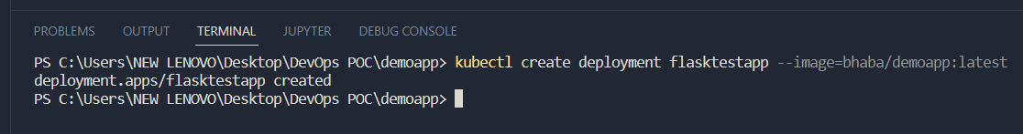
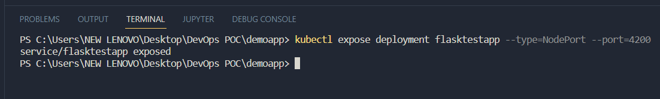
Accessing kubernetes service from outside
1) Open the folder that contains the application files in VS Code.
2) Run kubectl create deployment <service-name> --image=<image-name>:<tag-name> command to create a deployment.
3) Run kubectl expose deployment <service-name> --type=NodePort –port=4200 to expose the created Kubernetes service as a new Kubernetes service.

Slide 19
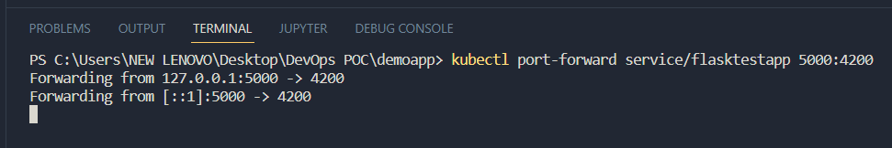
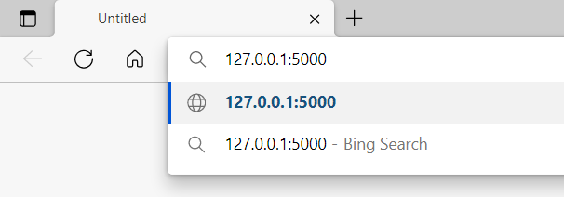
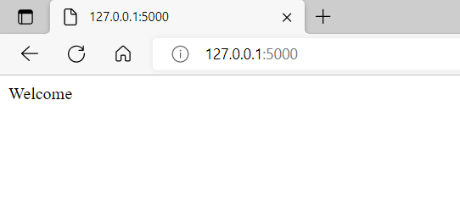
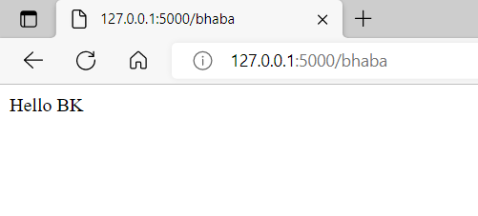
4) Run kubectl port-forward service/<service-name> 5000:4200 to set up a proxy that will forward all traffic from a local port that we specify to a port associated with the Pod that we determine.
5) Go to a browser and type 127.0.0.1:5000 as the url and press Enter to access the service.

Slide 20



Setting up Prometheus and Grafana into the Kubernetes Cluster
Prometheus is a free software application used for event monitoring and alerting. It records real-time metrics in a time series database built using a HTTP pull model, with flexible queries and real-time alerting.
Grafana is a multi-platform open source analytics and interactive visualization web application. It provides charts, graphs, and alerts for the web when connected to supported data sources. It allows us to query, visualize, alert on, and understand our metrics no matter where they are stored.

Slide 21
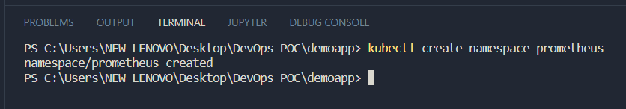
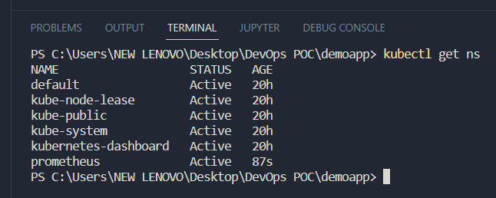
Steps for installation—
1) Run the kubectl create namespace prometheus command to create a namespace.
2) Run the kubectl get ns command to view the list of namespaces created.
3) Install helm.

Slide 22
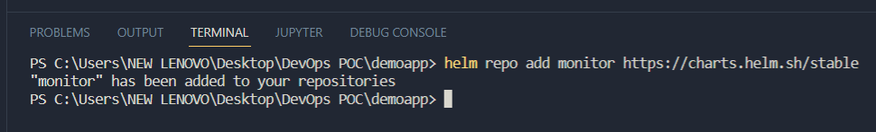
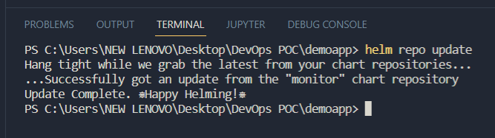
3) Run the helm repo add monitor https://charts.helm.sh/stable command to add monitor repository .
4) Run the helm repo add prometheus-community https://prometheus-community.github.io/helm-charts command to add prometheus-community repository.
5) Run the helm repo update command to update the latest information about charts from the respective chart repositories.

Slide 23
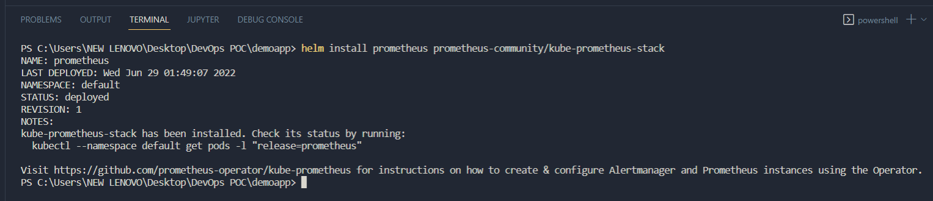
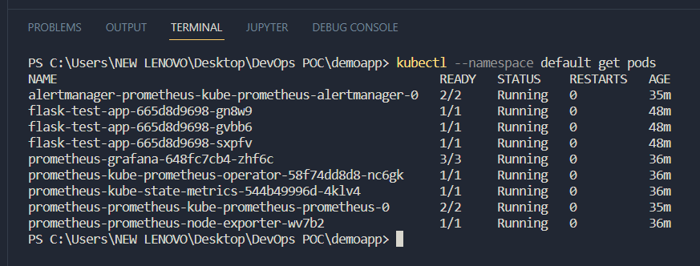
6) Run the helm install prometheus prometheus-community/kube-prometheus-stack command to install Prometheus and Grafana.
7) Run the kubectl –namespace default get pods command to view the list of pods created.

Slide 24
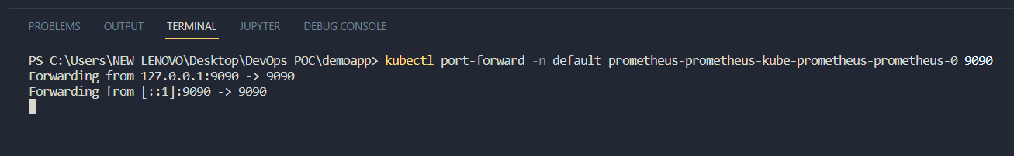
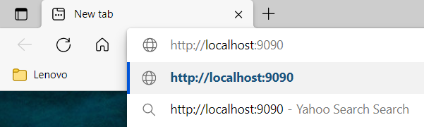
8) Run the kubectl port-forward –n <namespace> <name of prometheus-kube pod> 9000 to set up a proxy that will forward all traffic from a local port that we specify to a port associated with the Pod that we determine.
9) Go to a browser and type 127.0.0.1:9090 as the url and press Enter to access the service.

Slide 25
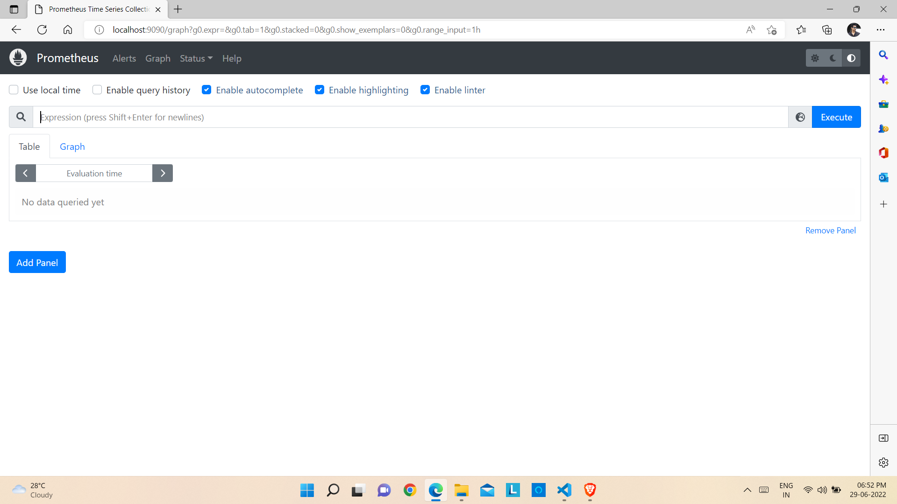
Prometheus Dashboard

Slide 26
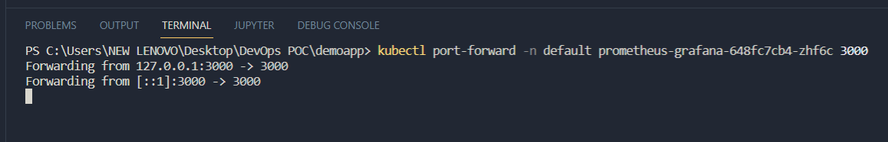
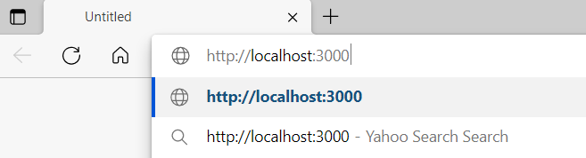
10) Run the kubectl –namespace default get pods command again to view the list of pods created.
11) Run the kubectl port-forward –n <namespace> <name of the prometheus-grafana pod> 3000 to set up a proxy that will forward all traffic from a local port that we specify to a port associated with the Pod that we determine.
12) Go to a browser and type 127.0.0.1:3000 as the url and press Enter to access the service.

Slide 27
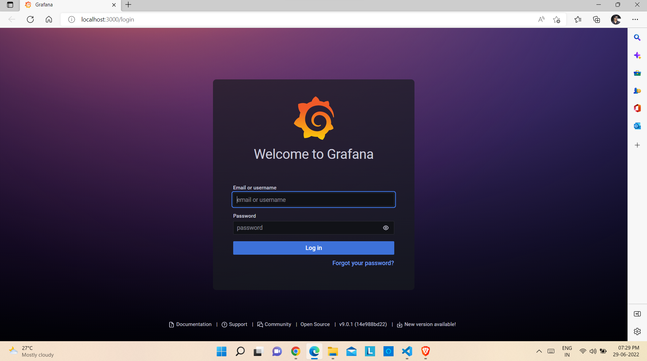
Grafana Login Page

Slide 28
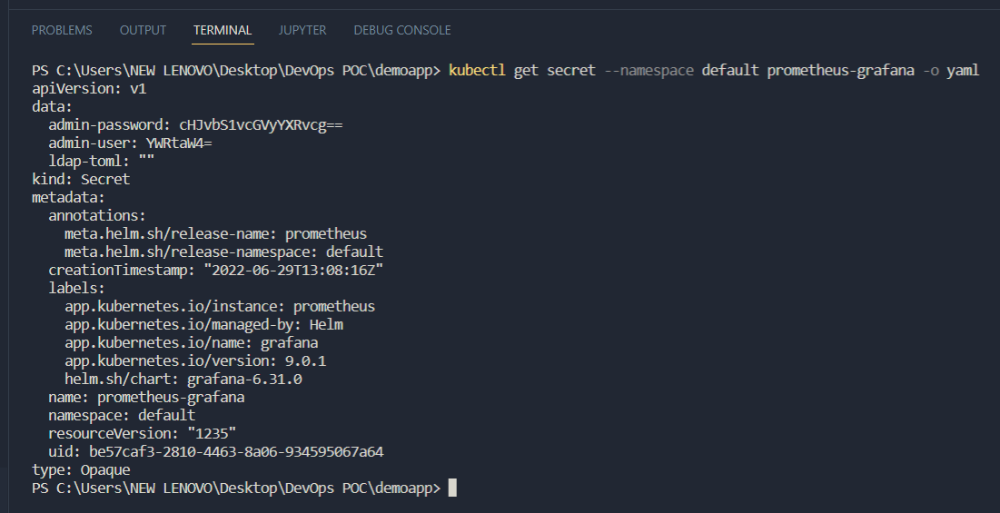
13) Run kubectl get secret –namespace <name of namespace> prometheus-grafana –o yaml command to check the encoded username and password for logging into Grafana dashboard.

Slide 29
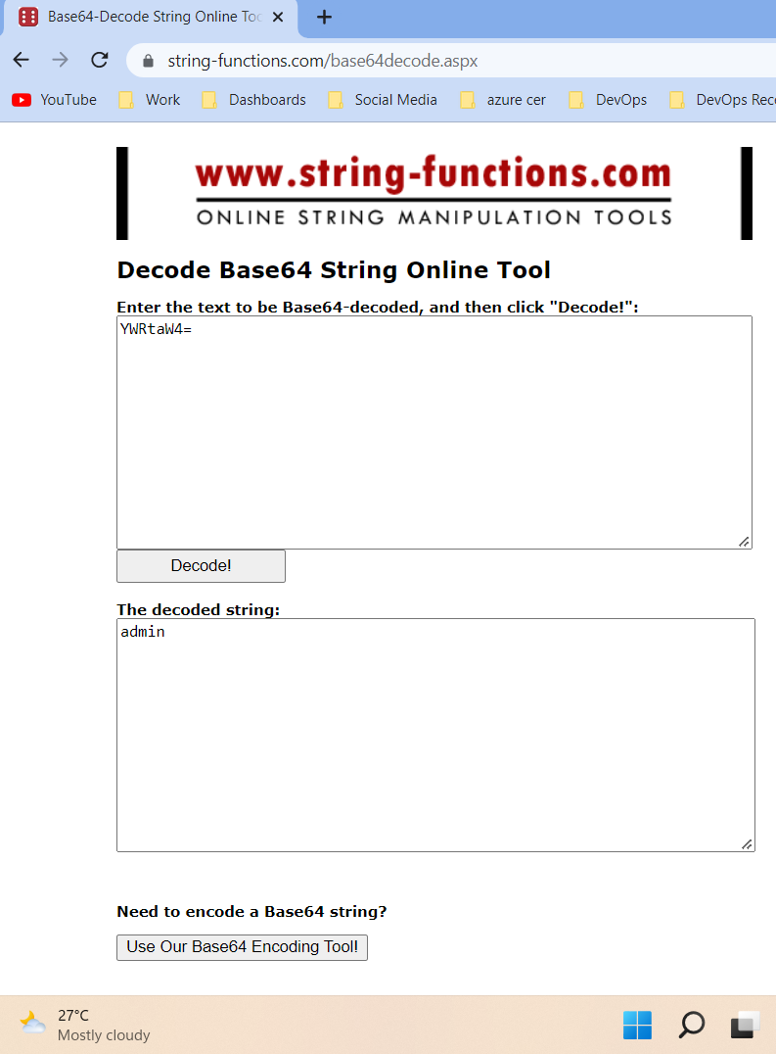
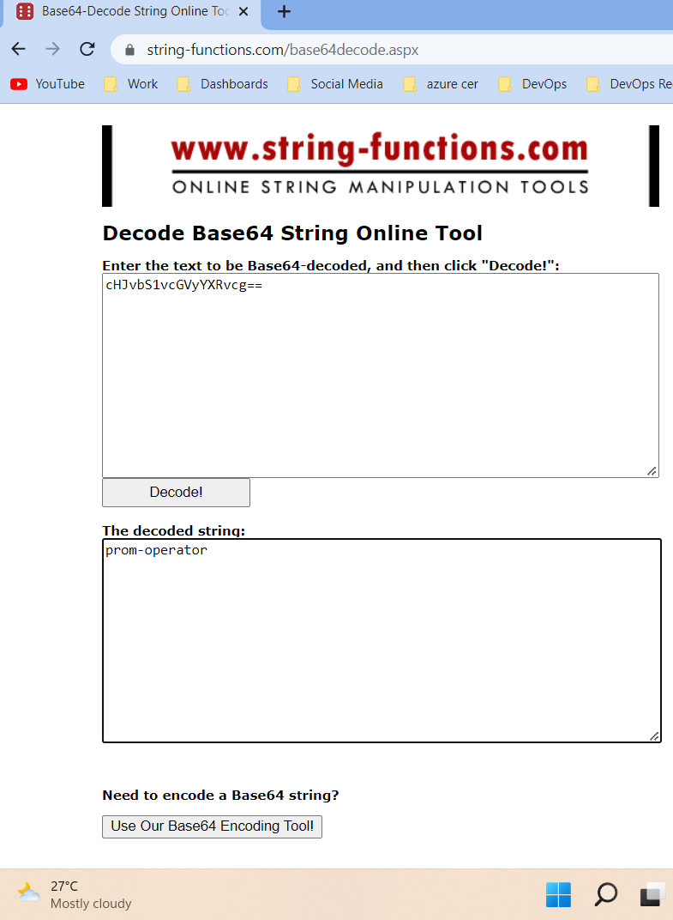
14) Open any online string decoder (For example, https://string-functions.com/base64decode.aspx) and decode the username first and then the password.

Slide 30
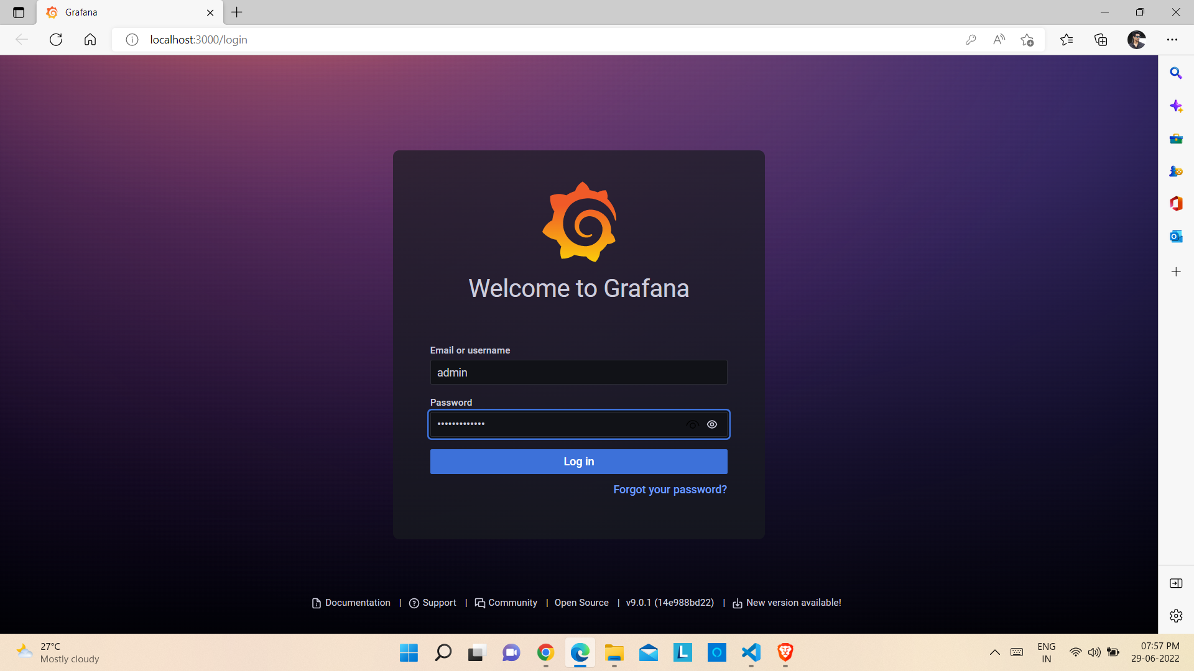
15) Enter the Username and Password on the Grafana login page and click on Log In.

Slide 31
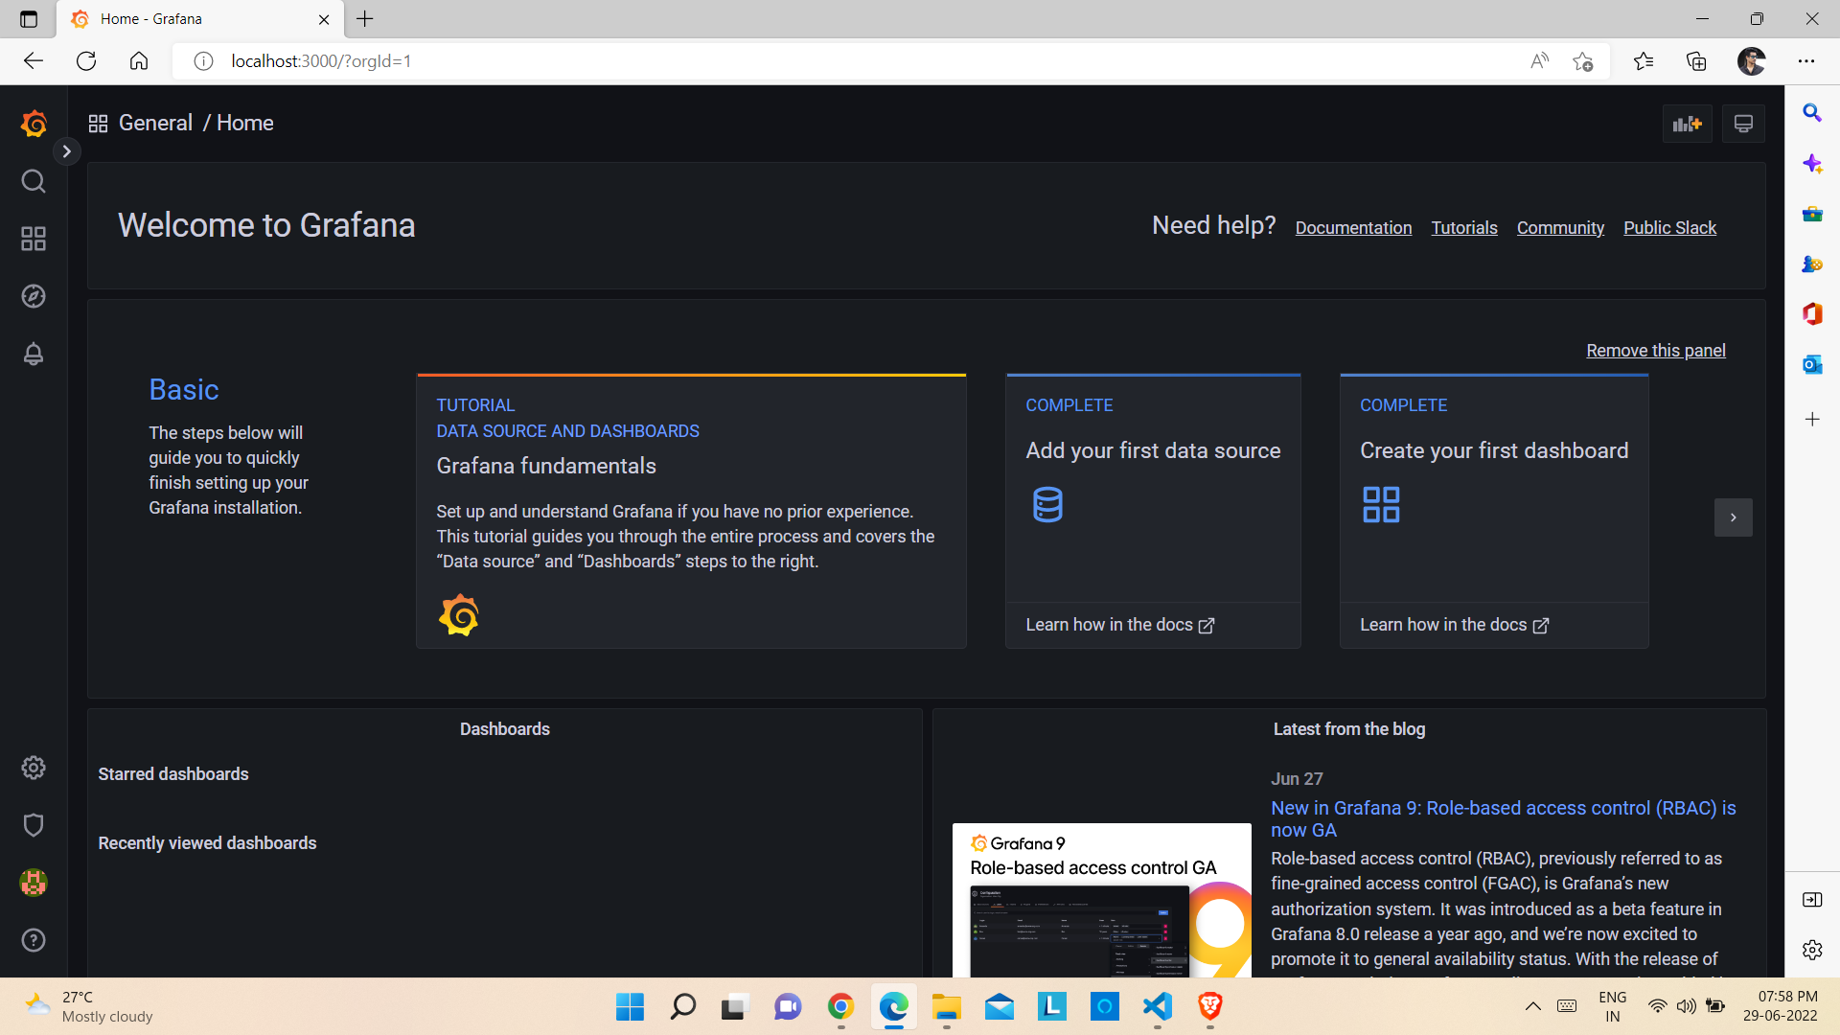
Grafana Dashboard

Slide 32
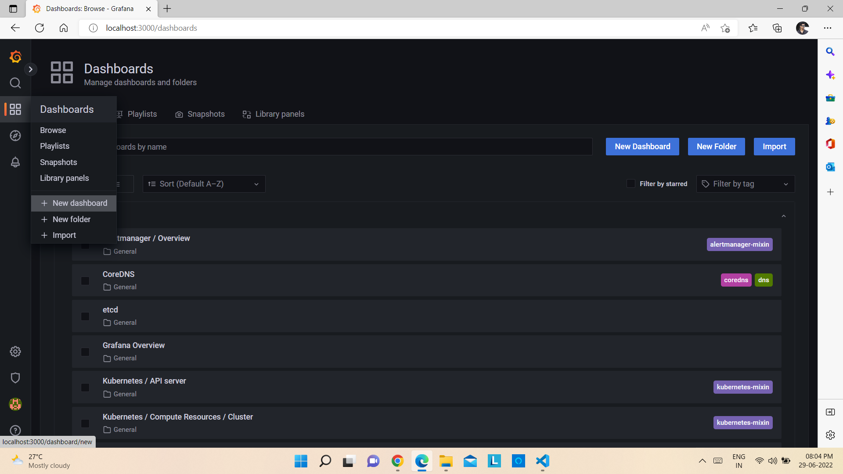
Designing dashboard in Grafana and visualizing deployed sample application CPU and memory status
1) Open Grafana Dashboard and click on Dashboards -> + New Dashboard.

Slide 33
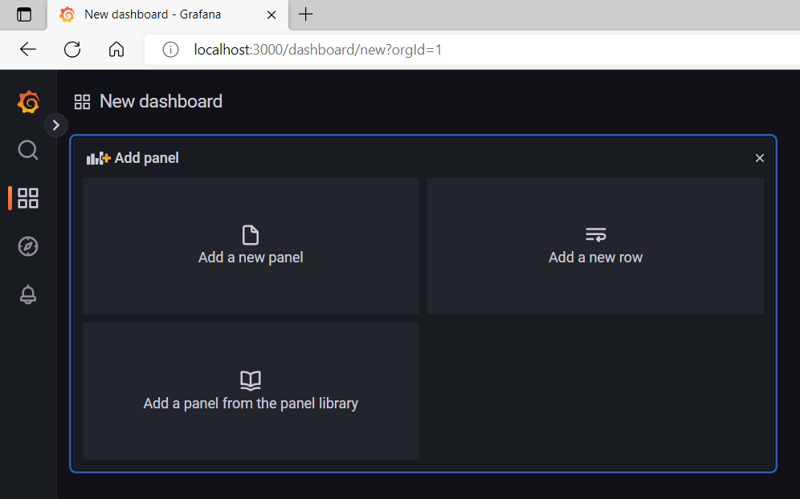
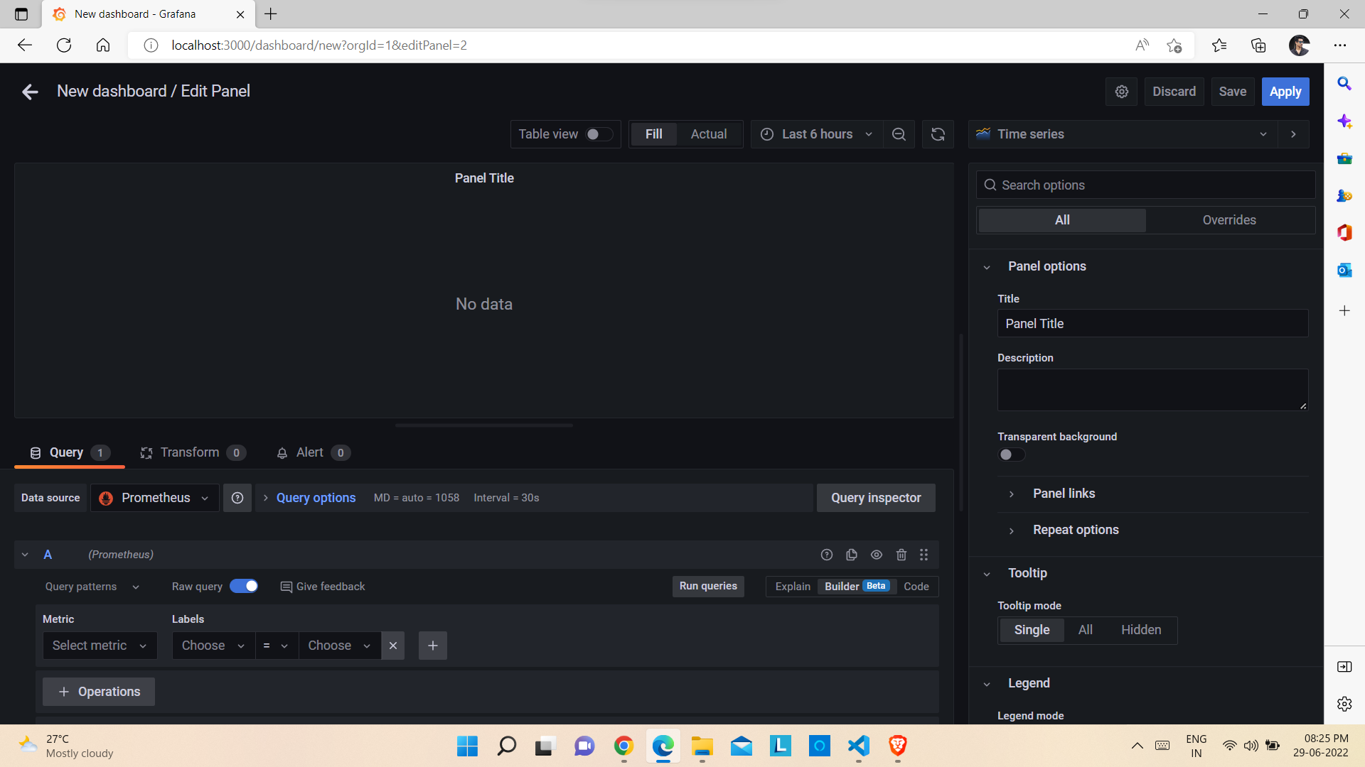
2) After that click on Add a new panel.
3) The Edit Panel window will be opened.

Slide 34
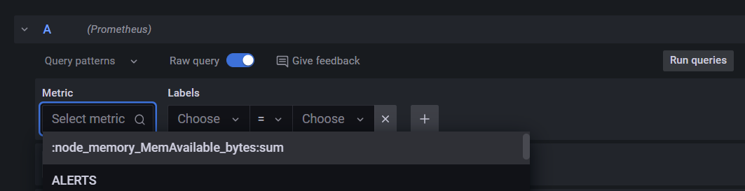
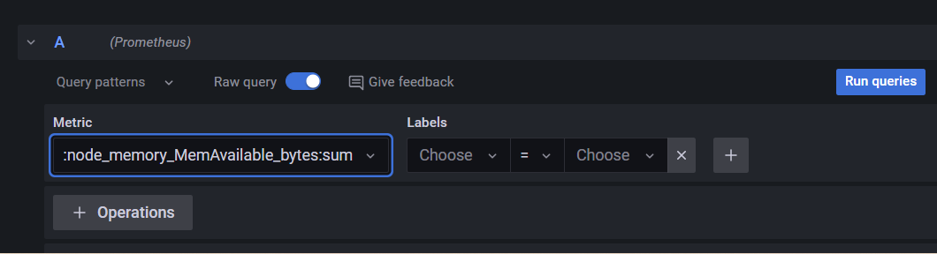
4) Click on Select metric and from the drop down list select node_memory_MemAvailable_bytes:sum and click on Run queries.

Slide 35


5) Click on + Query to add a new query.
6) Click on Select metric and from the drop down list select cluster:node_cpu:ratio_rate5m and click on Run queries.

Slide 36

7) Edit the Title and click on Apply.

Slide 37


8) The new dashboard will be added.
9) Click on Save button.

Slide 38


10) Give a name to the dashboard, select the Folder and click on Save to save the dashboard.

Slide 39
Thank you !

